Slide 1
WebEOC Daily Usage
April Taylor, FPEM, CEM
Deputy Emergency Manager
Notes:
DRAFT

Slide 2
City of Orlando Emergency Management
330, 000 residents
International and Executive airport
Major roadways
Tourist and Conference destination
Sports Venues
Office of Emergency Management
2 Full-time personnel

Slide 3
WebEOC – Automated Processes
EOC/OOC Room Reservations (9 different rooms)
Utilize Design Studio Forms to request room usage
Continuity of Government (COG)
Departments update their own information in the COG Board
EM Team Training Certificates
EM Team members update their own training certificates and keep rosters current
Region 5 Special Events Board

Slide 4
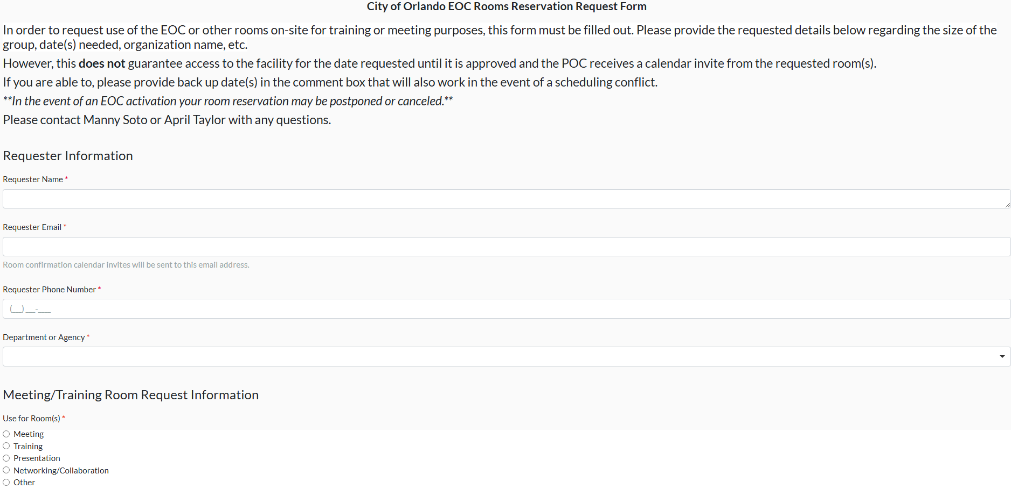
Room Reservations – Design Studio Forms

Slide 5
Room Reservations

Slide 6
Continuity of Government (COG)

Slide 7
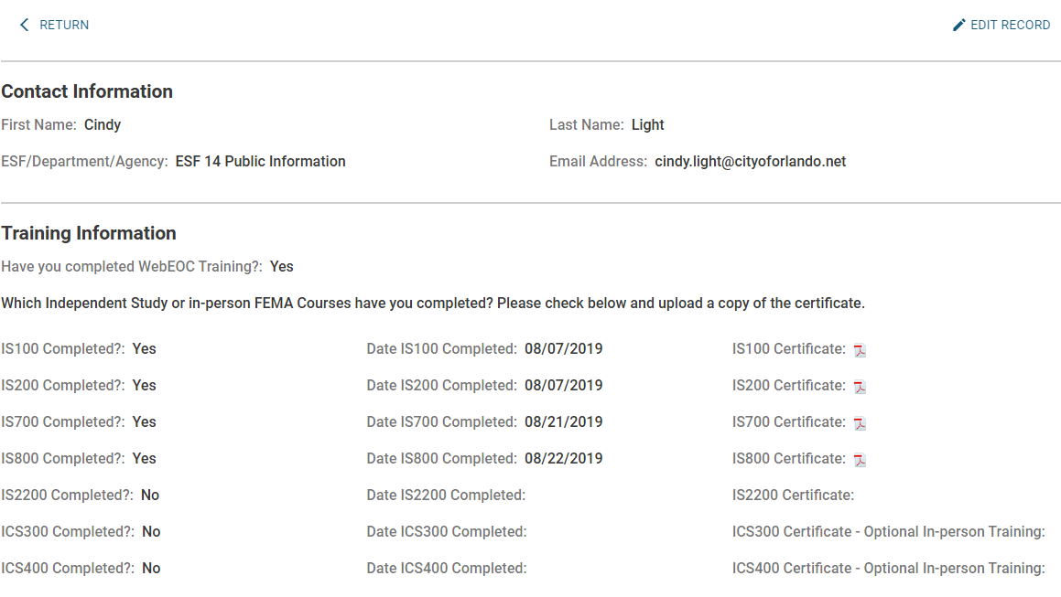
EM Team Training Records

Slide 8
Thank You!
April Taylor, FPEM, CEM
Deputy Emergency Manager
City of Orlando
april.taylor@cityoforlando.net

